Slide 1
Fashion Product Image Classiffication with Convoluntion Neural Network
By Hongling Yang

Slide 2
Objective
Import fashion product image dataset and label product/images with matching master categories (the target feature) provided in an acompanying catalog file.
Apply Transfering learning strategy and build a convoluntion neural network (CNN) to deep learn and extract information out of fashion product images. (supervised machine learning)
Train and tune the CNN model which will acheive over 95% classification accuracy.
Implement a similar appraoch (i.e., transfer learning, VGG16...) and build a recommendation system for fashion products/images. (unspupervised learning)
Data Source (Kaggle):
(https://www.kaggle.com/datasets/paramaggarwal/fashion-product-images-dataset)

Slide 3
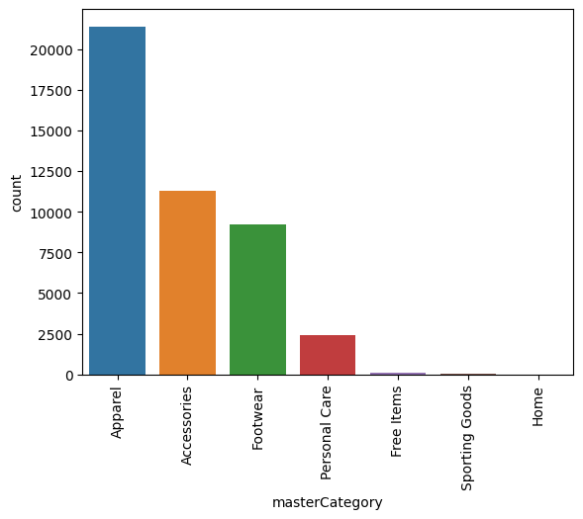
Distribution of Target Feature (Kaggle Dataset)
(1) Orginal Kaggle Dataset
 | masterCategory | Freq
Majority Classes | Apparel | 21,397
 | Accessories | 11,274
 | Footwear | 9,219
 | Personal Care | 2,403
Minority Classes | Free Items | 105
 | Sporting Goods | 25
 | Home | 1
***
Scaled Rating = Raw Rating/log (Rating Counts)
Scaled Tating is right -skewed,

Slide 4
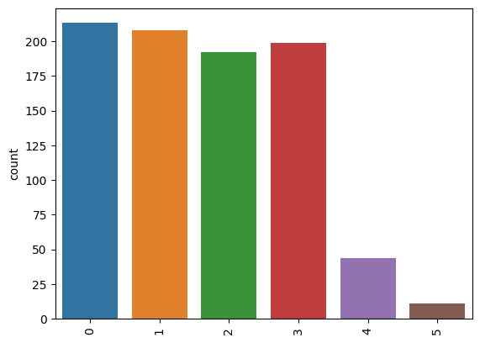
Distribution of Target Feature (Study Sample)
(1) Test Set of Study Sample
Study Sample (4,329 Images)
 | masterCategory | Freq
Majority Classes | Apparel | 1,000
 | Accessories | 1,000
 | Footwear | 1,000
 | Personal Care | 1,000
Minority Classes | Free Items** | 267
 | Sporting Goods** | 62
 | Home*** | 0
** Including 162 new ‘Free Items’ and 37 ‘Sproting Goods” generated by ImageDataGenerator()
***masterCategory ‘Home” is removed from classification

Slide 5

CNN Model Wihtout Hyperparameter Tuning
Un-tuned Model Topology __________________________________________________________ Layer (type) Output Shape Param # ==================================================== vgg16 (Functional) (None, 7, 7, 512) 14714688 flatten (Flatten) (None, 25088) 0 dense (Dense) (None, 50) 1254450 dense_1 (Dense) (None, 20) 1020 dense_2 (Dense) (None, 7) 147 =============================================================
Total params: 15,970,305 Trainable params: 1,255,617 Non-trainable params: 14,714,688
Squential Model:
VGG16 (wihtout top dense layers) + dense layer (neurons = 50)
+ dense layer (neurons=20) + output layer (neuron=7)

Slide 6
Classification Report
 | precision | recall | f1-score
Apparel | 0.99 | 0.98 | 0.98
Accessories | 0.92 | 0.94 | 0.93
Footwear | 0.99 | 0.99 | 0.99
Personal Care | 0.99 | 0.98 | 0.99
Free Items | 0.67 | 0.70 | 0.69
Sporting Goods | 0.92 | 1.00 | 0.96
accuracy |  |  | 0.96
macro avg | 0.92 | 0.93 | 0.92
weighted avg | 0.96 | 0.96 | 0.96
Train/test split at 80/20,
Optimizer = ‘adam’, epochs=10, batch_size=10, learning rate=0.001

Slide 7
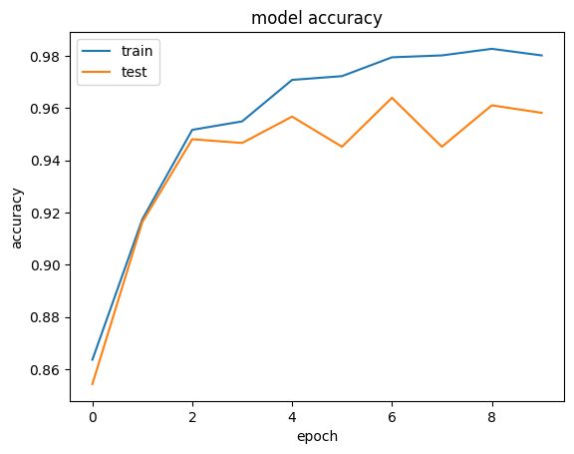
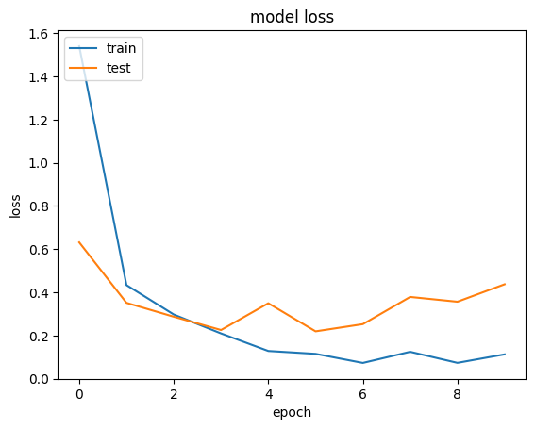
Un-tuned CNN Model Performance
test data accuracy: 0.959

Slide 8
Hyperparameter Tuning
3)Tuning three hyaperparameters:
the number of neurons in the first dense layer
the learning rate of the optimizer
the best number of epochs
The tuning is done in two steps.

Slide 9
Hyperparameter Tuning
Step 1. Set epochs =5 and tuned the number of neurons and the learning rate
(RandomSearch in Keras Tuner module).
Search spacing :
{‘neurons’ : (20, 40, 50), ‘learning rate’ : (0.01, 0.001, 0.0001) }
Searching Result:
{‘neurons’=20, ‘learning rate’ = 0.001}
Step 2. Set {‘neurons’=20, ‘learning rate’ = 0.001} and tune ‘epochs’
Set ‘epochs’ = 50 and trace the model the accuracy score on test set.
Searching Result: {‘epochs’=20}
Best Hyperparameters.
{'neurons': 20, 'learning_rate': 0.001, 'epochs': 36}

Slide 10
Tuned Model Classification Report
 | precision | recall | f1-score
Apparel | 0.99 | 0.98 | 0.98
Accessories | 0.90 | 0.94 | 0.92
Footwear | 1.00 | 0.99 | 0.99
Personal Care | 0.99 | 0.98 | 0.99
Free Items | 0.55 | 0.66 | 0.60
Sporting Goods | 0.00 | 0.00 | 0.00
accuracy |  |  | 0.94
macro avg | 0.74 | 0.76 | 0.75
weighted avg | 0.94 | 0.94 | 0.94
Train/test split at 80/20,
Optimizer = ‘adam’, epochs=10, batch_size=10, learning rate=0.001

Slide 11
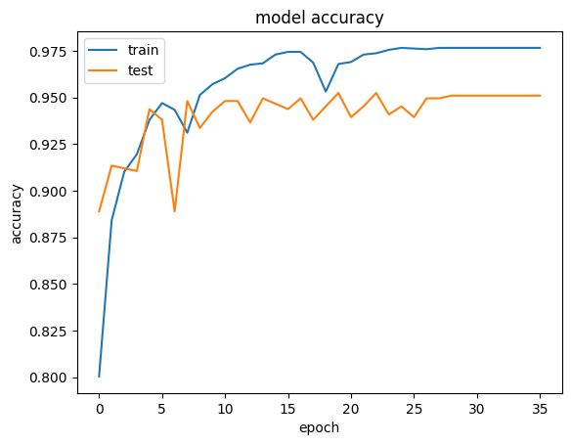
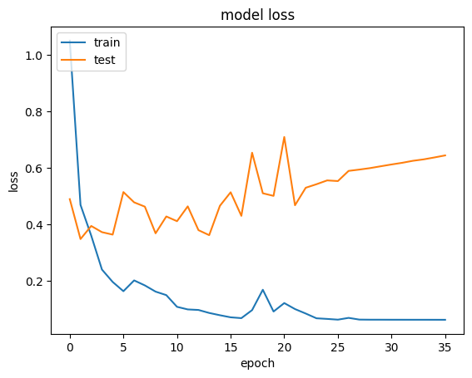
Hyperparameter-tuned CNN Model Performance
test accuracy: 0.945

Slide 12
Why Tuning Made Worse
Model perforamnce is wrose after tuning than before tuning
Possible Explanations:
Small search space with a Randomsearch engine. With only a few trials (=6) of Randomsearch. The optimal configuration may never be reached;
When tuning, models under different configurations are trained with ‘epochs’ = 5
Possible Solutions:
Expand search space and tune with an adpative searching engine (e.g., Hyperhand, BayesianOptimization).
Increase searching trials and ‘epochs’ = 5

Slide 13
Item-Based Recommendation System
Feature Extraxction:
Implement a pre-trained VGG16 model (including top dense layers)
return 1,000 new hiden features.
Different from the VGG16 base model in classification which does
not have top dense layers.
Closeness Meaure:
Metrc: the cosine similarity scores
Recommendations:
For a given product/image, the 4,328 similarity scores with other products/images are ranked. Products/Images with the top 5 highest scores are recoomeded

Slide 14
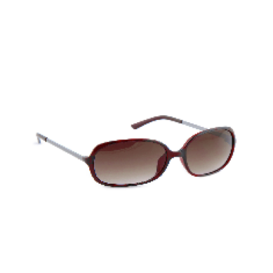
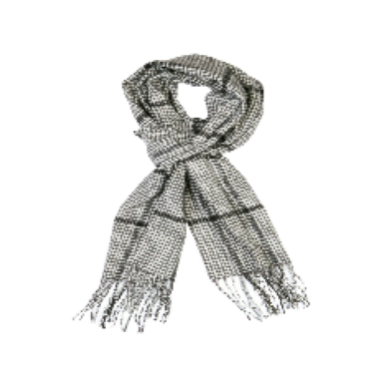
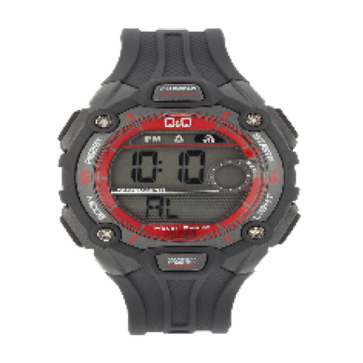
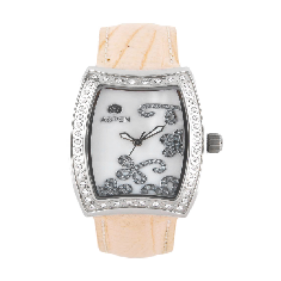
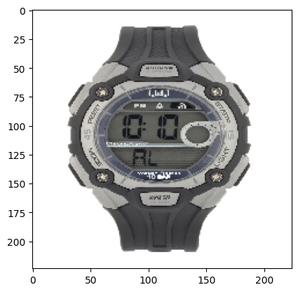
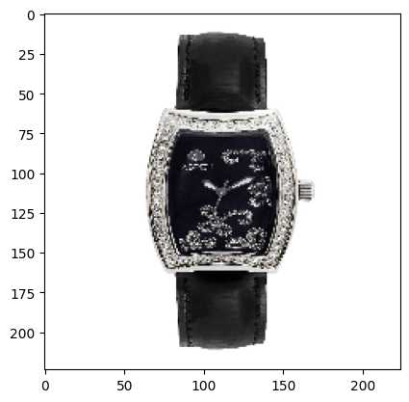
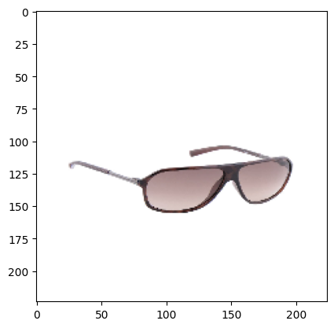
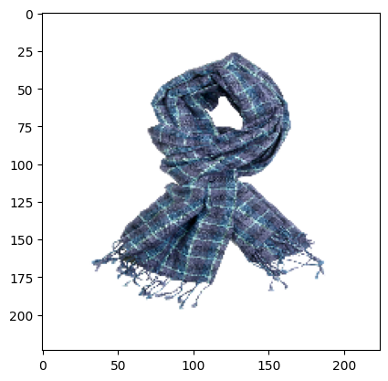
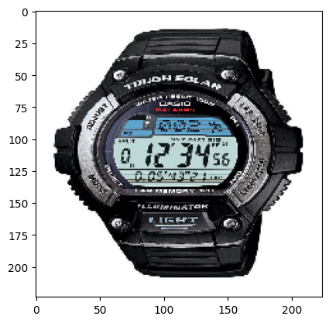
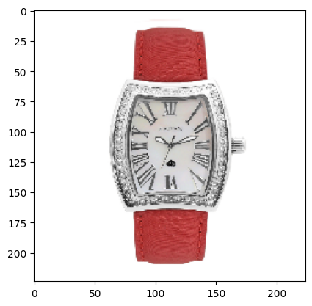
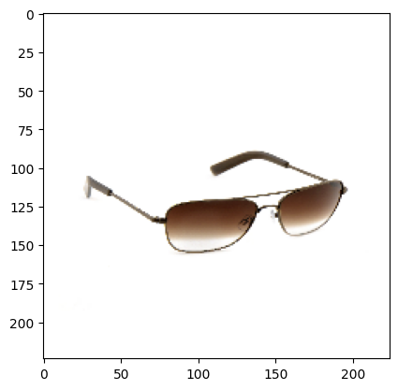
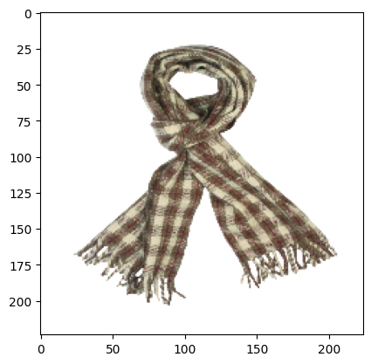
Visual Evaluation of Recommendation System
Orginal
Recommendations

Slide 15
Conclusion
The CNN model we bulit in this study can classify fashion products/images with a good accuracy (~96%).
Applying transfer learnig with a pre-trained classification model such as VGG16 saves resource and time. Model is built and trained fast with good satisfactory performance.
Transfer learning can also leverage feature extraction, which makes building Recommendation system easy and fast
Hyperparameter tuning is important in model configuration. Apply efficient search engines with decent search spaces and adequate numer of trails is necessary.
Randomsearch engine may not work well when resources are limited

Slide 16
What is Next
Utilize Google Colab or Kaggle Notebooks and test the CNN model on the entire 44K+ Kaggle dataset;
Make the model more robust, modular and portable for easy adoption by other image classification tasks.
Experiment with tuning other hyperparameters, such as Optimizers (‘adam’, ‘sgd’, or ‘rmsprop’?), the number of dense layers, and training bacth size…
Experiment with adding a dropout layer between two top dense layers to constrain the network from over-learning certain features.
Experiemnt with other per-trianed models (such as Xception, ResNet50, InceptionV3, etc. in Keras applications) as the base model.
Conitnue learning about deep Neural network in regression.

